Slide 1


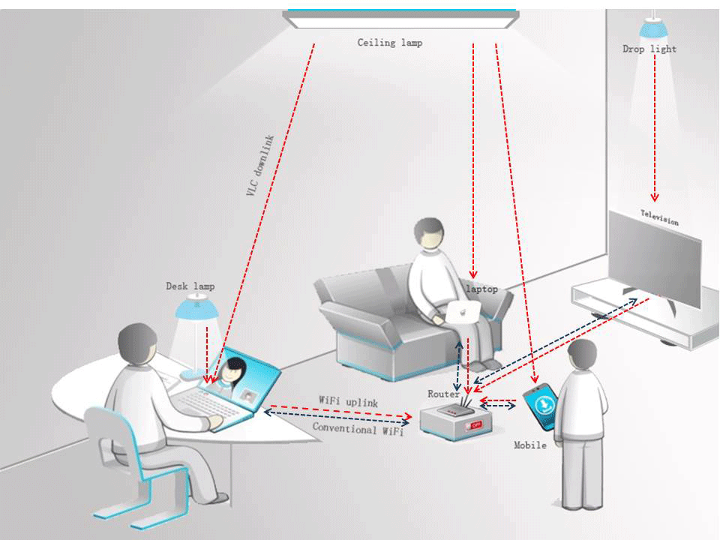
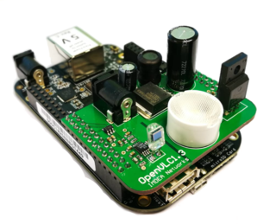


Li-Fi Communication
ECE 403 Senior Design
Sacdiya Sayid (EL)
Nelson Caberto (TL)
Visible Light Wi-Fi: Li-Fi uses visible light to transmit data between devices. Li-Fi is an emerging technology for indoor communication.
Greg Graham (IM)

Slide 2
Deliverables
What will you deliver by the end of the semester? (list your deliverables in bullet points)
Create two working OpenVLC devices
Demonstrate Simplex Communication
Send a Test File from one OpenVLC device to another
Send Strings from one OpenVLC device to another
Demonstrate Half-Duplex Communication (optional stretch goal)
Create a basic messaging program

Slide 3
Next Steps
Towards your final deliverables, what are you planning to accomplish immediately? (in 2 weeks time)
Transmit and Receive Intelligible Data Internally (A single bit and a series of bits)
Transmit and Receive Intelligible Data Externally (A series of bits at a slow speed and faster speed)
Transmit and Receive Intelligible Data at a Distance (Initially short, best case, and map out our maximum distance)
Upgrade RX Circuit – use better components (PhotoDiode vs PhotoResistor and dial in timings)
Upgrade TX Circuit – use better components (using various LEDs and dial in timings)
Partitioning of Tasks: (who is responsible for what)
All – Get test data for determining best timings and decisions to determine our communications protocol
Greg – RX Circuit Upgrade
Sacdiya – TX Circuit Upgrade
Nelson – Protocol Architecture

